Slide 1
Introduction to Survey Design for People with Lived Experience
Dr Michelle Jones
Full resource, see: https://www.ncrm.ac.uk/resources/online/all/?id=20858

Slide 2

Contents:
Defining the purpose of the survey
Ethics and risk mitigations
Building the survey
Testing the survey
Disseminating the survey
Analysing survey results
Closing the feedback loop

Slide 3

Defining the Purpose of the Survey:
What is the purpose of the survey?
- gain insights / knowledge
- shape and inform a project
- provide feedback
- light-touch way to share experiences
- encourage participation in future projects
How are you involving people with lived experience?
Survey to people with lived experience?
Survey designed by people with lived experience?
Survey designed by people with lived experience to people with lived experience?

Slide 4

Ethics and Risk Mitigations:
What do you need to consider for your own project?
- exclusion criteria?
- signposting for support?
- do you need to include trigger warnings?
- impact of being risk-averse?
- accessibility and inclusivity?
- informed consent?
- explicit consent to share or use direct quotes
TOP TIP: Ask people with lived experience about terminology and how identified risks can be mitigated.

Slide 5
Building the survey:
Ensure the survey is updateable – give participants the option to save and return to the survey, especially if the content is heavy
Ensure you have plenty of open text questions, so participants have the option to share their insights and experiences
Try to avoid compulsory response questions and allow participants the option to skip questions they do not wish to answer
If asking a closed text question, follow this up with an open text question to offer participants the opportunity about why they responded in a particular way
Check language to ensure it is accurate and sensitive
When working with people with lived experience, think about any training needs so that people can actively engage and participate in the research process
Recognise that people with lived experience have professional expertise too
Include a final question asking for any further comments or feedback to give participants the opportunity to mention anything that is important to them that might have been missed.
TOP TIP: Remember that the survey is about understanding insights rather than producing replicable, quantifiable data!

Slide 6

Testing the survey:
Check the length of the survey, particularly if the subject content is heavy
Ensure the opportunities to save and return to the survey are working
Ask people with lived experience to test the survey
Check language and terminology to make sure it is accessible, inclusive and sensitive
Check all links work
Check the survey is accessible across different devices and media
TOP TIP: Ask people with lived experience to test your survey and make changes where necessary!

Slide 7
Disseminating the survey:
Provide a clear introduction statement about the purpose of the survey to ensure informed consent
If asking sensitive questions, be upfront and tell the participant the type of questions that could be asked before they begin the survey
Approach relevant networks and community groups to ask if people will participate or they can share in their newsletters or communications
People with lived experience may have access to their own networks and can share within their communities, this can help to build trust and improve participation
Be clear if you have any exclusion criteria. If someone cannot participate, explain why and, if possible, offer an alternative approach to sharing their experience
Ask people with lived experience where to share the survey link for innovative ideas and suggestions
TOP TIP: Make use of networks and community groups to share your survey and encourage participation

Slide 8
Analysing survey results:
Remember that surveys with people with lived experience are different to traditional research surveys, the aim is not to produce replicable, generalisable, or quantifiable results
Ensure you set aside plenty of time to analyse survey results – with more open text responses, more time will be needed to conduct analysis
Look for key themes and trends
Accept there may be a divergence of experiences and opinions, this will make the data richer
Look for nuances in your findings
If working with people with lived experience, think about their skills sets and comfort levels – do they need further support or training to analyse results?
Consider providing emotional support to anyone analysing the survey results
Think about how results can be presented and the audience they will be presented to
TOP TIP: Recognise the diverse skills sets people with lived experience may have and build these into the analysis and dissemination of findings

Slide 9
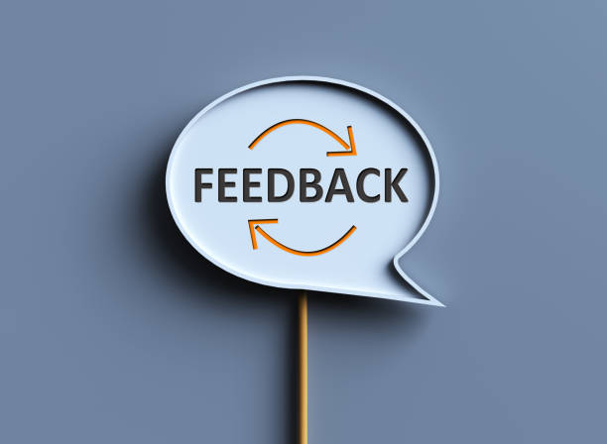
Closing the feedback loop:
People have taken the time and energy to share their stories and experiences, if appropriate build opportunities for feedback into your research design
Explain clearly when and how the results will be used
If the purpose of the survey is to receive feedback, explain how this feedback has impacted the research project and what changes have been made
Think about further opportunities for people to be involved in the research
If changes cannot be made, be open and honest and explain why
If possible, provide a timeline about the next steps and keep people updated
Offer participants the opportunity to sign up to updates about the project
TOP TIP: Ensure communications are authentic and thank people for their time!

Slide 10
www.ncrm.ac.uk

